Slide 1
How IIoT Makes Machines and Devices More Effective & Intelligent
David Barnett
Vice President, Products & Markets

Slide 2

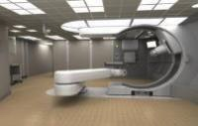

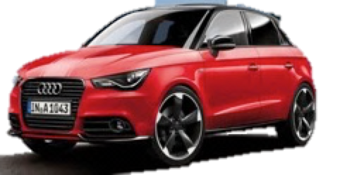
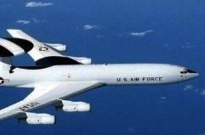
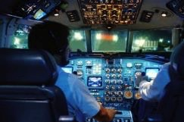
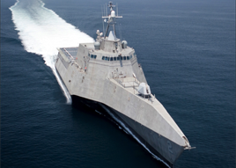
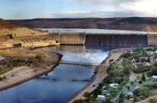
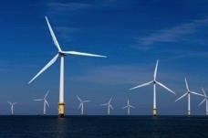
IIoT Scope
Healthcare
Autonomous Vehicles/Transportation
Aerospace & Defense
Energy
Notes:
To begin with, I want to define what I mean by IIoT.
Because of initiative like Industry 4.0, many people associate the IIoT primarily with manufacturing and traditional process automation markets.
I define IIoT in line with the Industrial Internet Consortium. Cyber-physical systems that serve industry. This is as opposed to the consumer IoT.

Slide 3
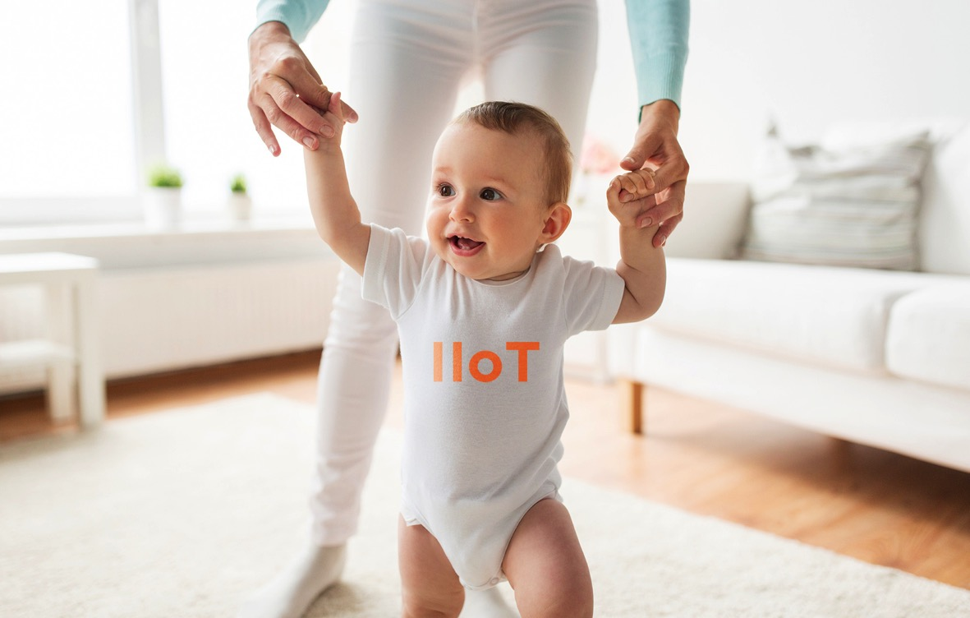
IIoT Is in Its Infancy

Slide 4
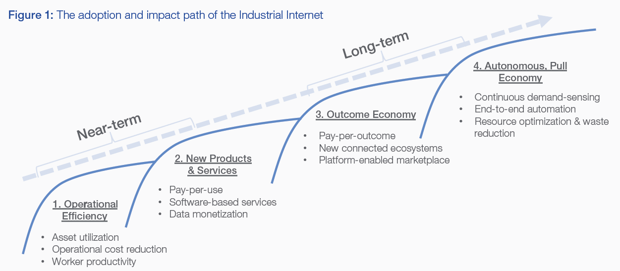
IIoT Phases
Source: World Economic Forum, January 2015
Industrial Internet of Things: Unleashing the Potential of Connected Products and Services
Notes:
In a January 2015 report produced in collaboration with Accenture, the World Economic Forum outlined four phases of IIoT evolution.
It starts with applications we hear about today. For example, improving asset utilization through tracking and predictive analytics/maintenance. And improved efficiency through remote management.

Slide 5

(Industrial) IoT Today
Most intelligence
Analytics and Services
in the Cloud
More connectivity
Notes:
When people think of IoT today, they tend to think of cloud
Machines are getting much more connected, but they’re not getting much smarter. We’re putting most of the new intelligence in the cloud.

Slide 6
Goal: Autonomy
Dramatic Improvements in Efficiency, Reliability, Safety and Outcomes
Automotive
  Advanced driver assistance
  Self-driving cars & trucks
  Dynamic real-time traffic routing
  Smart parking
Healthcare
  Smart alarming
  Clinical decision support
  Closed loop control
Energy
  Efficient integration of distributed energy resources
  Autonomous, islandable microgrids
  Maximize return on capital of power plants (e.g., wind)

Slide 7
Cloud-Centric Not Appropriate for Autonomy
Cloud-Centric Limitations
Data volumes
Latency
Safety, reliability, resilience
Needs
Intelligence → edge
Decentralization
Efficient fan out
Self-forming, self-healing
Formal safety certification
Analytics and Services

Slide 8

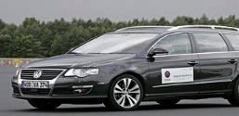

Architecture for Autonomous IIoT Systems
Intelligence in the Fog
Streaming Analytics
& Control
HMI/UI
IT, Cloud &
System of Systems
Connectivity
Software Databus
Sensors
Actuators
Notes:
Industrial Internet of Things is about bringing intelligence to edge control systems.
Devices must talk to each other
Make thousands of control decisions per second
The introduction of a software databus makes this possible.
data-centric connectivity framework
Manage real-time data
Enable applications and devices to work as one, integrated system
Definition of Databus for Marketing
DDS is a software databus which is a data-centric framework for distributing and managing real-time data in the Industrial IoT. It allows applications and devices to work together as one, integrated system.

Slide 9
Healthcare System of Systems
9
IT/Cloud
HIS
PACS
LIS
Cloud Server
IT Systems Databus
Recording Services
Mobile
v
Fog
Ward
Nurses Station
Decision Support
Ward Databus
GATEWAY
Edge
Room
Smart Alarming
Patient Monitor
Infusion Pump
Patient Room, Operating Room or ICU Databus
Temp
BP
EKG
Ventilator
Data Recording
Notes:
Hospitals need systems of systems because….
Alarm fatigue leads to accidental patient deaths
Need intelligence at every level
HIS: Hospital Information Systems
PACS: Picture Archiving and Communication System
LIS: Laboratory Information System
Show mobile/cellular connection off top level databus
Use lightning to show cellular connection

Slide 10
Transportation System of Systems
Maintenance
Availability
Fleet Management Databus
Traffic Management
Road Management
National Operations Center of Excellence
HMI
Municipal Cloud Databus
V2X Databus
GATEWAY
Fleet Management Weekly
Autonomous Vehicle
Telematics
Situation
Awareness
Planning
Sensors
Vehicle Control (Safety Critical)
GPS
Camera
LiDAR
Sensor
Fusion
Data Recording
CAN
AUTOSAR
Notes:
Futuristic but imminent architecture for self-driving cars.
Commercial Fleet Management of thousands of vehicles
- predictive maintenance
- vehicle availability
These systems have to be in place
Municipal Management
- Traffic management
- Road management
- Public Safety
Each vehicle needs a databus for communications between sensors and vehicle drives, and between vehicles themselves.
RTI helps build these architectures by providing the technologies to build these layered-databus architectures.

Slide 11
Smart Grid System of Systems
Demand
Response
Compliance
Risk
Management
Enterprise
Server
Enterprise Service Databus
Recording Services
HMI
GATEWAY
Analytics Databus
Microgrid Optimizer
Micro Grid
Battery
Switch/
Recloser
Edge Control Databus
PV
Meter
Micro Grid
Controller
Data Recording
Notes:
Similar architecture where analytics are performed at different

Slide 12

New IIoT Architectures: Begin with the End in Mind
Operational Efficiency
Intelligent and Autonomous
Streaming Analytics
& Control
HMI/UI
Cloud Connectivity
Software Databus
Sensors
Actuators
Centralized, hierarchical
Decentralized, systems of systems
Notes:
To move from operational efficiency to autonomy requires changing architecture from centralized and hierarchical systems to decentralized and layered systems of systems

Slide 13
Thank You!

