Slide 1
Multi Trusted Execution Environment for IoT
Building a Trust Continuum for IoT Applications
Itai Yarom, MIPS
Notes:
Introduction to be added …
Summary of presentation flow –
Start with overview of the home automation market prediction out of the IoT total market (maybe Volker IoT slide + IoT home automation slide)
Show 2-3 examples of home automation attacks.
Show customers survey about concerns.
Show the growth with secure and unsecure devices.
Talk about the security framework

Slide 2
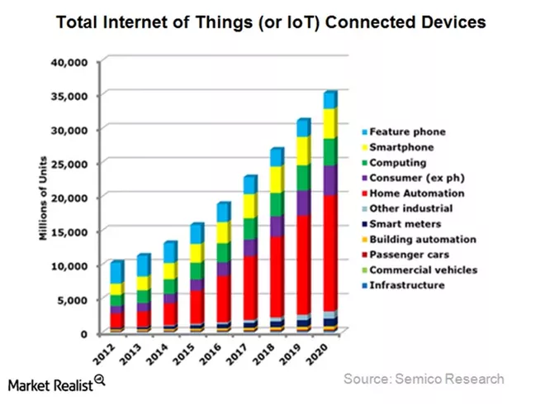
Home automation IoT segment
The biggest IoT segment
Home Automation is the dominated connected devices segments
Faster growth compared to traditional markets, like smartphones.
Faster growth than other IoT segments, like automotive and consumer electronic.
Big segments is what hackers are looking for…

Slide 3
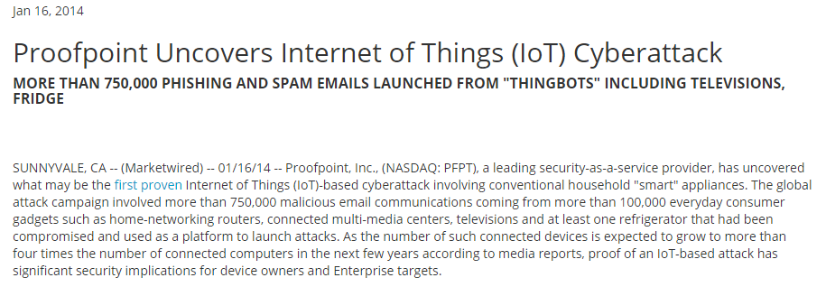
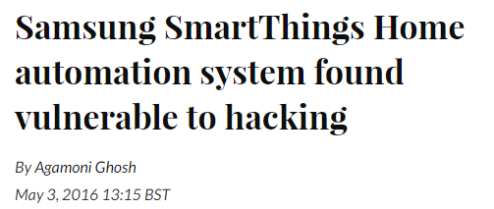
Security Attacks on Home Automation
Being the biggest segment makes it the target for attacks
Are we concern about those attacks and hacks?

Slide 4
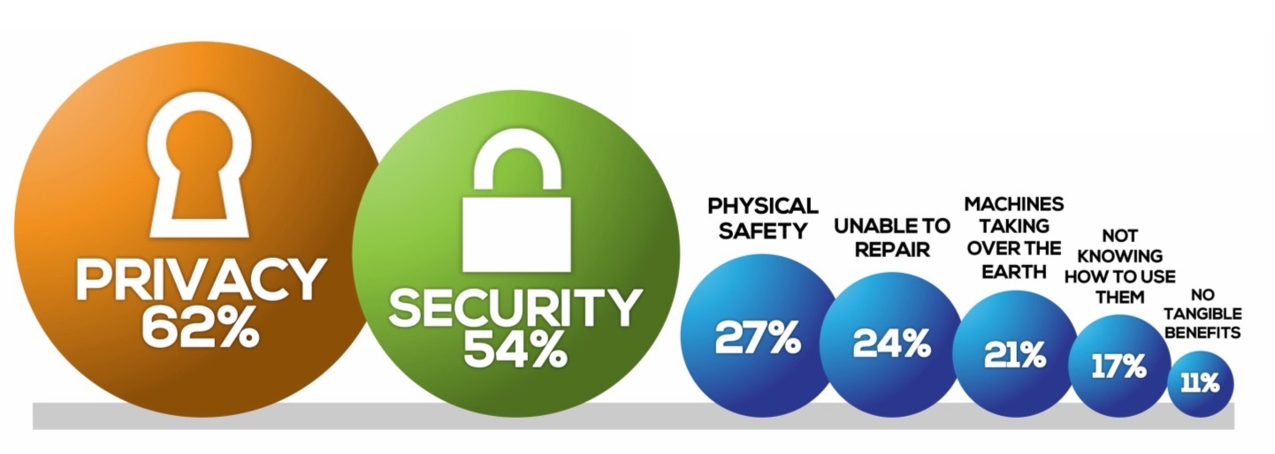
What would concern you about a world of connected devices?
Privacy and Security are the clear concern
Source: MEF Global Consumer Trust Survey 2016

Slide 5
Which object would you be most concerned about being connected to the Internet?
Besides cars all items mentioned below are home automation items
Source: MEF Global Consumer Trust Survey 2016

Slide 6
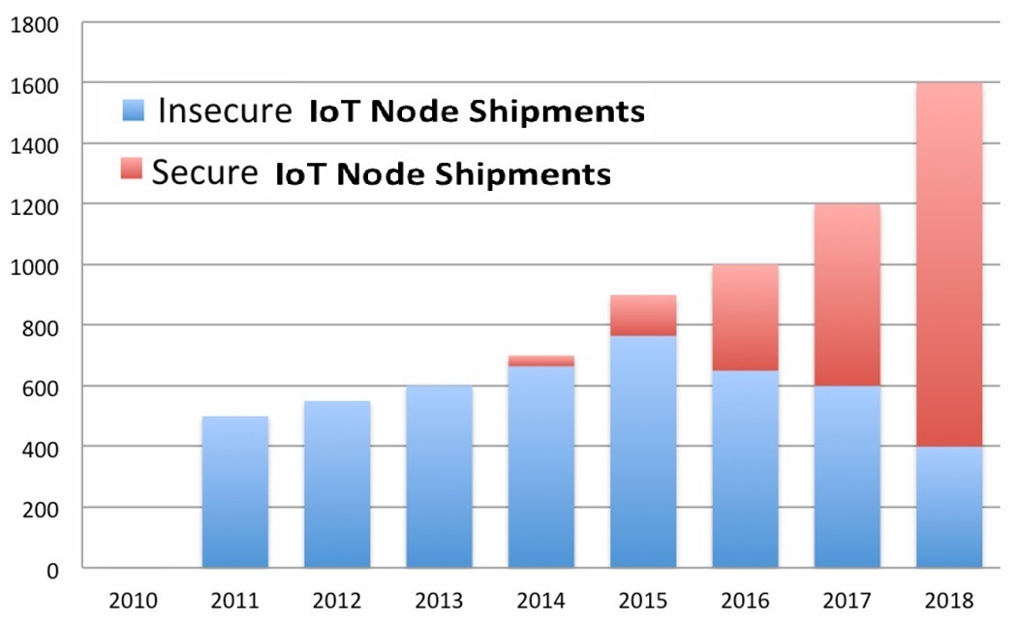
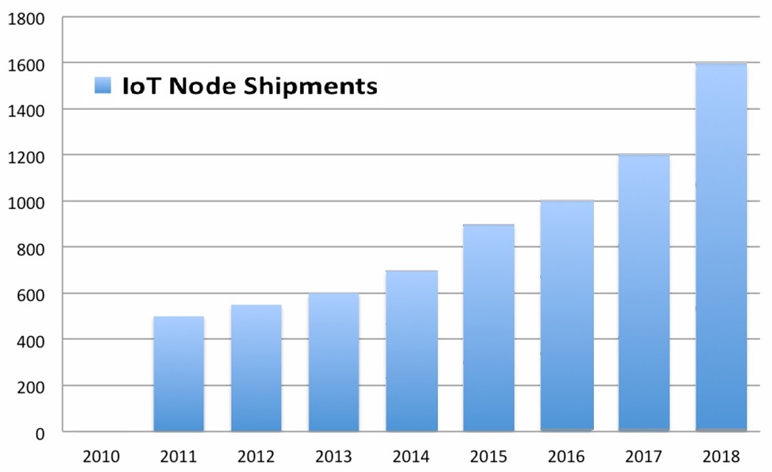
IoT Nodes Shipment by Year in Million of Units
A 2nd Look on the IoT market growth
IoT device security is driven by consumer concern, regulation and as a response to recent attacks
How do we add security to connected devices?
What can we do with insecure devices?
Notes:
Silicon TAM Chart on right.

Slide 7
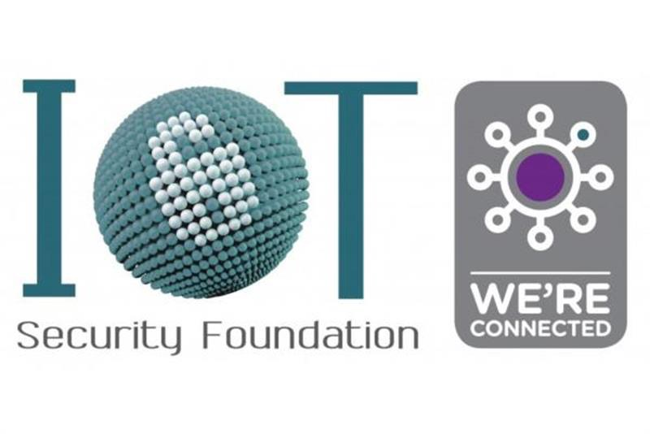
Security for Connected Devices
Enabling next-generation SoC security
Multi-domain separation-based architecture
Beyond binary: each secure/non-secure app/OS can operate independently
Scalable to address heterogeneous architectures
OmniShield-ready hardware and software IP
Designed to provide the industry’s most scalable, secure solutions for protection of next-generation SoCs
Open guidelines and recommendations
Ensures security & reliability
Changing use models in connected devices require a new security approach to protect OEM products and operator services
Notes:
https://iotsecurityfoundation.org/the-internet-of-things-security-foundation-has-launched/
The Internet of Things Security Foundation (IoTSF)has officially launched and set out its plans to respond to rising concerns surrounding cybersecurity challenges in IoT. The creation of IoTSF follows an eight month investigative and consultative process which included staging the IoT Security Summit at the world famous Bletchley Park earlier this year. IoTSF has an executive steering board comprised of leading technology organisations and security experts including BT, Vodafone, Imagination Technologies, Royal Holloway University of London, Copper Horse Solutions, Secure Thingz, NMI and PenTest Partners. John Haine, industry veteran and visiting professor at the University of Bristol has been announced as the inaugural chair.

Slide 8
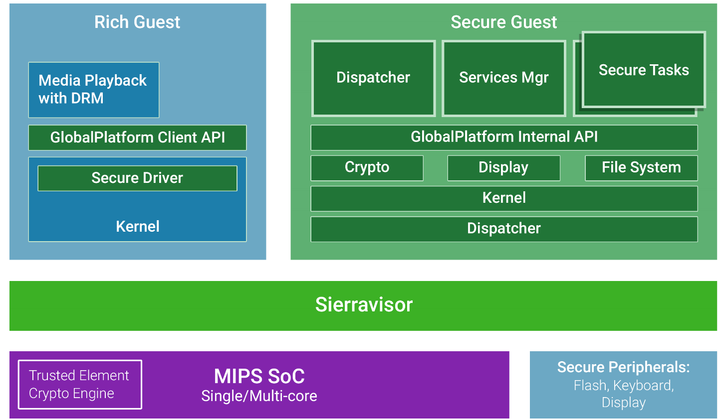
What is Trust Execution Environment (TEE)
Notes:
https://iotsecurityfoundation.org/the-internet-of-things-security-foundation-has-launched/
The Internet of Things Security Foundation (IoTSF)has officially launched and set out its plans to respond to rising concerns surrounding cybersecurity challenges in IoT. The creation of IoTSF follows an eight month investigative and consultative process which included staging the IoT Security Summit at the world famous Bletchley Park earlier this year. IoTSF has an executive steering board comprised of leading technology organisations and security experts including BT, Vodafone, Imagination Technologies, Royal Holloway University of London, Copper Horse Solutions, Secure Thingz, NMI and PenTest Partners. John Haine, industry veteran and visiting professor at the University of Bristol has been announced as the inaugural chair.

Slide 9
Trusted Element (TE)
Establishing Immutable Root of Trust (RoT)
Secure Boot
Authenticate the origin and the integrity of the Image before execution
Secure Storage
Storage within the cryptographic area for Root Public Key (permanent) and Versatile memory (temporary)
PUF*
Secure Communication
Communication between the AP / SoC and TE
Secure JTAG
Ability to control debug, monitoring and access to the SoC
Tamper Detection / Response
Protection against physical attacks
Self destruct (secure storage zeroization)*
Side Channel Attacks*
Platform
CPU
Cores
OCM
TE- Cryptographic Boundary
Secure Boot
GPU
Cores
Secure Comm
Off-
loads
Secure Storage
Secure JTAG
I/O
Tamper Detection/ Response
PUF
Network
Interface
NV-
RAM
JTAG
DDR
Wired
Wireless
OS/Apps
9￼

Slide 11
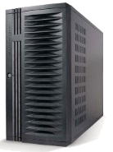
Challenges with the connected home
eHealth
Orthogonal services
PCI
DRM
Each service requires a virtual private distributed system embedded within the physical IoT environment
Security
Operator / Cloud services
Medicine cabinet
Home security
Content
delivery
Home Gateway
Trusted
Services
Router
Services
Appliances
Retail
eHealth
Trusted hypervisor
Internet
Comm
CPU
Comm
RoT
Crypto
Instruments
Secure
storage
External memory
DDR, Flash, …
(.bin, .data)
Entertainment
11￼

Slide 12
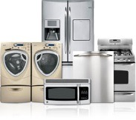
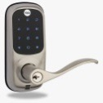
prpl Trust Continuum
❷
Multiple concurrent trusted flows
3rd Party eHealth
Hospital
CPE / HGW
Medicine Cabinet
3rd Party
Home Security Services
TAM
Client
REE
Router
Services
TRE
Home Security
TRE
eHealth
Services
Hypervisor
Appliances
Operator
MIPS
Internet
RoT
Comm
Crypto
Instruments
Secure
Storage
External Memory
DDR, Flash, …
(.bin, .data)
Home Security
TEE – Trusted Execution Environment
TRE – Trusted Runtime Environment
REE – Rich Execution Environment

Slide 13
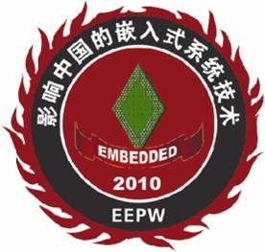
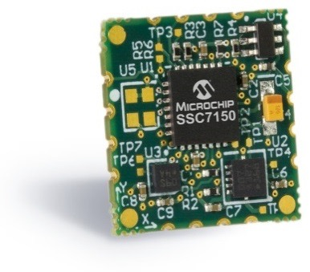
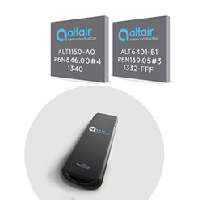
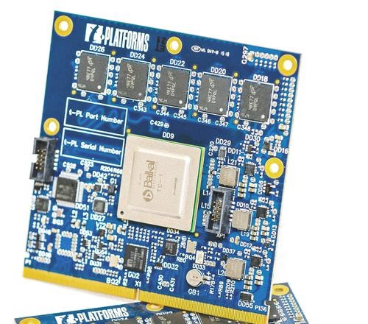
Developer platforms for connected device
All support security and virtualization out-of-the-box
Winner: Leading Product
Winner: Best IP
Winner: Best Processor IP
MIPS PIC32EZ (MIPS M5150)
9-Axis sensors
Accelerometer/Magnetometer
and Gyroscope
Baikal T1 (MIPS P5600)
IoT Hub with wired and wireless connection
On board security chip
Altair FourGee 1150/1160 (MIPS M5150)
LTE Cat1/Cat0 Modem

Slide 14
Summary
Home automation is one of the leading IoT segments
Including various types of system from security camera to lighting.
There is an increase focus on security to address customers concern, grown amounts of attacks and regulation requirements.
The key method of security is to provide trusted execution environment
Having isolated trust environment for each application is important
MIPS provides certified TEE solution using 3rd party collaboration
Developer kits are available from partners
Trusted Execution Environment for Multi application is the key component for secure IoT systems

